Slide 1
STAT7001 – Computing for Practical Statistics 2015 Lecture 7
Custom Routines
and Numerical Optimization
Dr Franz J. Király

Slide 2
Course organization updates
First In-Course-Assessment
Grading will start after end of late submission period (Mar 02, 11:55 pm)
Feedback will be available on your digital TurnitIn submission
Grades and feedback are provisional until examiners‘ meeting in June
Second In-Course-Assessment
Handing out: Mar 02 (on moodle) Submission: Mar 30, 11:55 pm = Monday midnight
Groups are randomised (R code on moodle)
Sheet and data available on moodle today
Group work for second ICA
You should have liaised with your group partners by now
if they did not respond: go to workshops and find them in person
workshop instructors will offer assistance in locating them
Please inform us if you could not make contact by Wednesday the 4th

Slide 3
Control Statements

Slide 4
R Control Statements
Conditional execution of code with if … else …
if(condition)
Example: check whether input is 42
{
executed if condition is true
x <- 41
}else
if(x==42) answer = "yes"
{
else answer = "no"
executed if condition is false
}
answer
{etc} brackets blocks of code
the else statement is optional
x <- 42 etc
Repeated execution of code with for … in …
for(variable in vector_or_list)
Example: compute sum of integers
{
some code with variable in it
total <- 0
}
for(n in 9:92)
runs the code in brackets repeatedly where
total <- total + n
variable takes all values in vector_or_list
total
Other control statements: while, repeat, switch
Type help(Control) to consult the on-line help for more details

Slide 5
SAS Control Statements
Conditional execution of code with if … else …
if condition then
Example: check whether input is 42
do;
executed if condition is true
x = 41;
end;
if(x==42) answer = ’yes’;
else
do;
else answer = ’no’;
executed if condition is false
this creates a string variable/column with the name answer depending on the variable x
end;
do; etc end; brackets blocks of code
the else statement is optional
Repeated execution of code with do … to …
do index=start to lim by incr;
Example: compute sum of integers
some code with index in it
total = 0;
end;
do n=9 to 92;
runs the code in brackets repeatedly where
total = total + n;
index takes values between start and lim
end;
by is optional, incr is increment, by default 1
creates variables/columns total and n
Other control statements: do while, do until, goto /link

Slide 6
Custom Functions

Slide 7







Functions in
Programming
Mathematics
outputY <- functionF(inputX)
Intuition:
Input
Function f, functionF
Output
inputX
outputY
every function has a specific input/output signature, for example:
inputX is a string
functions can have parameters such as
functionF(input1,input2,paramN)
an example of a function in R:
cor takes a numeric matrix/data frame and computes correlation matrix
cor(mtcars[,2:4], method = "pearson")
(method is an optional parameter set via = )
(cor(mtcars[2:4]) also works)
To get the output matrix as a variable in the workspace:
corrmat<-cor(mtcars[,2:4], method = "pearson")

Slide 8
Custom Functions in R
are defined via function syntax
functionname <- function(input,param1=default1,…){
…
inputs/parameters are in parentheses
return(outputvar)
default values are specified by =defaultvalue
}
inputs and parameters are treated the same
return statement gives back a single object (can be list/array/vector)
defines a function with name functionname
call from later code just as other functions:
exampleresult <- functionname(42,param1 = 2)
unnamed arguments are by default the first
exampleresult <- functionname(42)
parameters take default value if specified
See section 1.5 of Maindonald/Braun or use the help function
by typing help("function") – with quotation marks

Slide 9
R examples: subtraction and mean
Example: subtracting two integers
subtract <- function(x,y=1){
return(x-y)
}
subtract(2,4)
subtract(6)
Example: computing the mean of a vector
mymean <- function(inputvec, excludeNA=TRUE){
if(excludeNA) inputvec <- inputvec[!is.na(inputvec)]
totalsum <- 0
for(entry in inputvec) totalsum <- totalsum + entry
return(totalsum/length(inputvec))
}
mymean(c(1:83,NA),F)
mymean(c(1:83,NA))

Slide 10
Custom Functions in SAS
encapsulate functions via the PROC fcmp
PROC fcmp outlib = sasuser.funcs.test;
functions are stored in outlib
function functionname(input1,input2,…);
specifices the signature
…
the function‘s name is functionname
return(outputvar);
return speficies the output
endsub;
functions have to end with endsub
run;
options cmplib = (sasuser.funcs etc, other libraries);
list of libraries from which to use routines
DATA somedata;
PROC someproc;
or
…
outputresult = functionname(var1,var2,…);
…
custom functions are used just as built-in ones
run;
Type help fcmp or consult the on-line help for more details
https://support.sas.com/documentation/onlinedoc/base/91/fcmp.pdf

Slide 11
SAS example: subtraction
PROC fcmp outlib = sasuser.funcs.subtract;
function subtract(x,y);
result = x-y;
return(result);
endsub;
run;
options cmplib = sasuser.funcs;
DATA somedata;
input x y;
z = subtract(x,y);
datalines;
1 2
6 4 …
run;

Slide 12
SAS example: mean, variable arguments
PROC fcmp outlib = sasuser.funcs.mymean;
function mymean(inputvec[*]) varargs;
totalsum = 0;
varargs means that the number of arguments can vary
do i = 1 to dim(inputvec);
totalsum = totalsum + inputvec[i];
end;
return(totalsum/dim(inputvec));
endsub;
run;
options cmplib = sasuser.funcs;
DATA somedata;
infile …;
input x1 -- x5;
meanx = mymean(x1,x2,x3,x4,x5);
run;
alternative: input an array

Slide 13
Subroutines in SAS
A subroutine modifies variables without explicitly returning them
PROC fcmp outlib = sasuser.funcs.test
subroutine routinename(input1,input2,…);
do something to input1, input2,…
e.g. input1 = input1 + 1;
endsub;
run;
options cmplib = sasuser.funcs;
DATA somedata;
PROC someproc;
or
…
CALL routinename(var1,var2,…);
…
invokes routine routinename to run on var1, var2
run;
Type help fcmp or consult the on-line help for more details
https://support.sas.com/documentation/onlinedoc/base/91/fcmp.pdf

Slide 14
Calling DATA and PROC from within FCMP
solution: define an encapsulating macro
%macro macroname();
starts definition of macro macroname
PROC someproc;
variables are referenced by
&varname1, &varname2, …
these should be the same as passed later
run;
include variable for result, e.g. &resultvar
quit;
%mend macroname;
ends definition of macro macroname
PROC fcmp outlib = …;
function macrofun(varname1,varname2,…);
rc = run_macro(“macroname”,varname1,…,resultvar);
if rc eq 0 then return(resultvar);
else return(.);
run_macro executes macros
endsub;
returns 0 in case of success
run;
type help run_macro for more details

Slide 15
Optimization Basics

Slide 16






Finding zeroes: Newton-Raphson method
„objective function“
Idea: start with an approximation
Improve this approximation by intersecting tangent with x-axis

Slide 17





Newton-Raphson stopping criteria
Start with an approximation
Improve this approximation by intersecting tangent with x-axis
Nothing guarantees that this will terminate!
(a-priori)
Possile/recommended stopping criteria:
relative change in y-coordinate is small
relative change in x-coordinate is small
a certain number of iterations is reached
the function value becomes too big

Slide 18




Minimization of functions
With Newton-Raphson
(this is a theorem)
(or on the boundary of the domain – this has to be separately treated if domain is not everything)
By Gradient Descent
Multiple variables:
Simple Newton-Raphson:
Gradient descent:

Slide 19
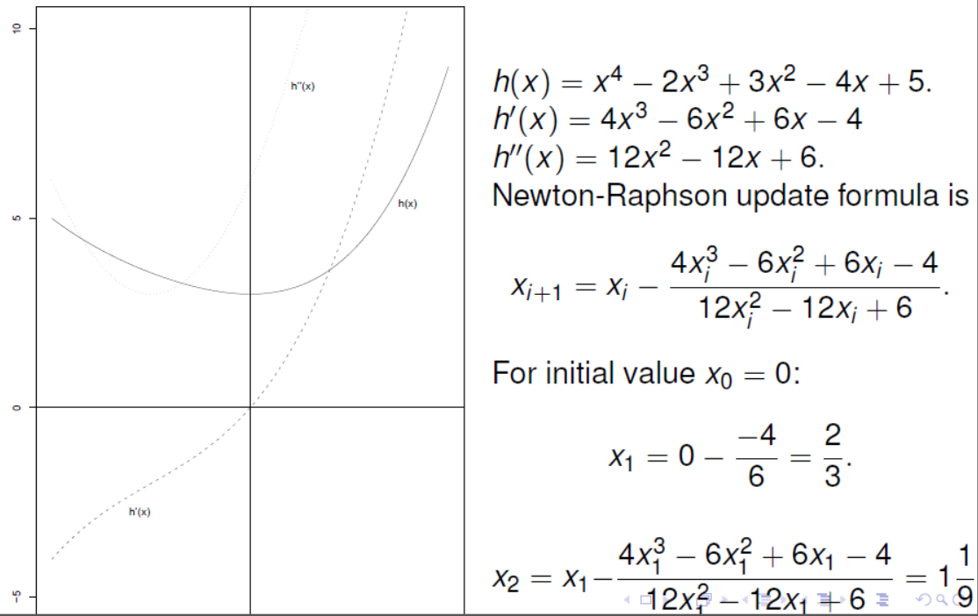
Example: Newton-Minimization

Slide 20
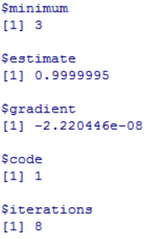
Minimization in R
use the nlm function for non-linear minimization
functiontominimize <- function(x) x^4 – 2*x^3 + 3*x^2 – 4*x + 5
simple functions can also be defined without the {}
nlm(functiontominimize,initialvalue)
the minimum function value (y-value)
the minimum argument (x-value)
the gradient at the minimum argument
why termination occurred.
read help nlm for a list. 4 and 5 are bad, 3 may be.
number of iterations total
results are sometimes better and faster if functiontominimize returns an explicitly known gradient and Hessian
via (optional) gradient and hessian attributes
type help(nlm) for details on how to pass these to the minimizer

Slide 21
Minimization in SAS
use the PROC nlp for non-linear minimization
PROC nlp;
min f;
decvar x;
f = x**4 – 2x**3 + 3*x**2 – 4*x + 5;
run;
nlp can do as well:
minimization in multiple arguments
decvar x1 x2;
least-squares-minimization of multiple functions
lsq f1 f2;
constrained optimization
bounds x > 42;
Advanced optimization features in SAS:
http://support.sas.com/documentation/cdl/en/ormpug/66851/PDF/default/ormpug.pdf
https://support.sas.com/resources/papers/proceedings10/242-2010.pdf

Slide 22
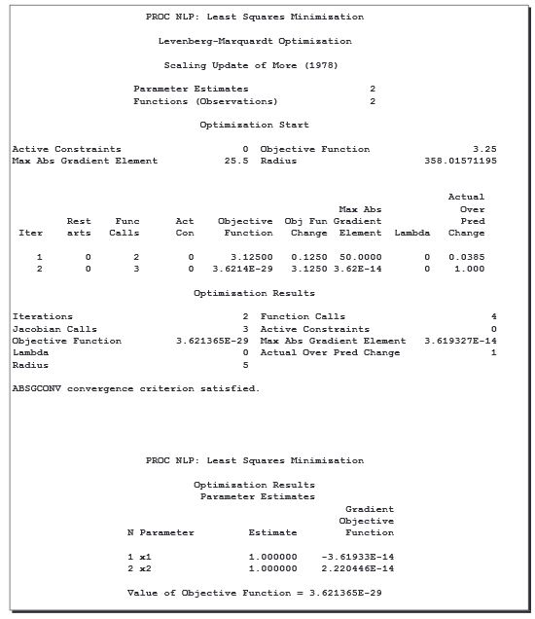
Minimization in SAS – sample output
Intermediate results (for each step):
y-value at each step
y-value change
gradient (maximal entry)
for constrained optimization only:
active constraints
slack variables
Summary of the above
Why the optimization terminated
(important!)
Final results:
y-value of minimum
x-value of minimum
gradient at the minimum

Slide 23
Next Week: Model and Method Validation
How to decide which model is „best“
How to evaluate and compare methods

Slide 24
Week 7 Learning Objectives
Functions and routines
Understand control statements in R and SAS
Understand how functions and routines work
arguments, local and global variables, outputs
Writing functions in R and SAS
Use and signature of functions in R
Using the PROC fcmp in SAS, functions and routines
Optimization Basics
Understand the Newton-Raphson method
Understand minimization by Newton-Raphson
Optimization routines in R and SAS

